Slide 1
DATA STRUCTURES & ALGORITHMS WITH JAVA
Lesson 4: Recursion & Dynamic Programing

Slide 2
Recursion Algorithms
Section 1

Slide 3
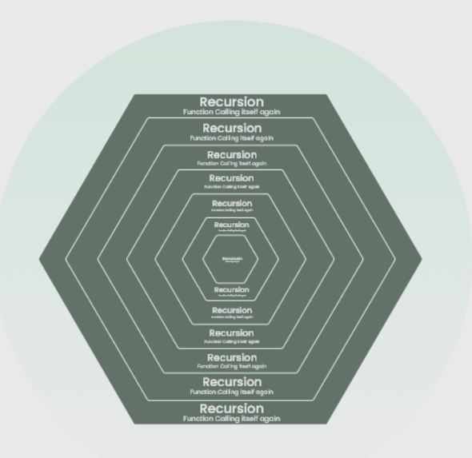
What is Recursion?
The process in which a function calls itself directly or indirectly is called recursion. Using a recursive algorithm, certain problems can be solved quite easily.

Slide 4
What are Recursion Functions?
A recursive function solves a particular problem by calling a copy of itself and solving smaller sub-problems of the original problems.
Many more recursive calls can be generated as and when required.

Slide 5
Need of Recursion
Recursion is an amazing technique with the help of which we can reduce the length of our code and make it easier to read and write.
Performing the same operations multiple times with different inputs.
In every step, we try smaller inputs to make the problem smaller.
Base condition is needed to stop the recursion otherwise infinite loop will occur.

Slide 6
Algorithm: Steps
Step1 - Define a base case: Identify the simplest case for which the solution is known or trivial. This is the stopping condition for the recursion, as it prevents the function from infinitely calling itself.
Step2 - Define a recursive case: Define the problem in terms of smaller sub-problems. Break the problem down into smaller versions of itself, and call the function recursively to solve each sub-problem.
Step3 - Ensure the recursion terminates: Make sure that the recursive function eventually reaches the base case, and does not enter an infinite loop.
Step4 - Combine the solutions: Combine the solutions of the sub-problems to solve the original problem.

Slide 7
Mathematical Interpretation
Calculate sum of first n natural?
approach(1) – Simply adding one by one
f(n) = 1 + 2 + 3 +……..+ n
approach(2) – Recursive adding
f(n) = 1 n=1
f(n) = n + f(n-1) n>1

Slide 8
Store Recursion
How are recursive functions stored in memory?
Recursion uses more memory, because the recursive function adds to the stack with each recursive call, and keeps the values there until the call is finished.
stack - LIFO (LAST IN FIRST OUT)

Slide 9
Base condition in recursion
The solution to the base case is provided and the solution to the bigger problem is expressed in terms of smaller problems.
int fact(int n)
{
if (n < = 1) // base case
return 1;
else
return n*fact(n-1);
}

Slide 10
Solved using recursion
The idea is to represent a problem in terms of one or more smaller problems, and add one or more base conditions that stop the recursion.
For example, we compute factorial n if we know the factorial of (n-1). The base case for factorial would be n = 0. We return 1 when n = 0.

Slide 11
Stack Overflow Error
If the base case is not reached or not defined, then the stack overflow problem may arise.
int fact(int n)
{
// wrong base case (it may cause
// stack overflow).
if (n == 100)
return 1;
else
return n*fact(n-1);
}
Notes:
If fact(10) is called, it will call fact(9), fact(8), fact(7), and so on but the number will never reach 100.
So, the base case is not reached. If the memory is exhausted by these functions on the stack, it will cause a stack overflow error.

Slide 12
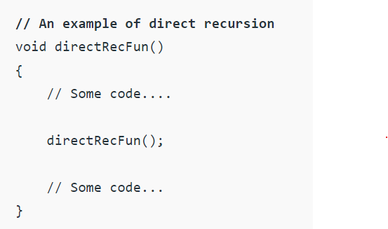
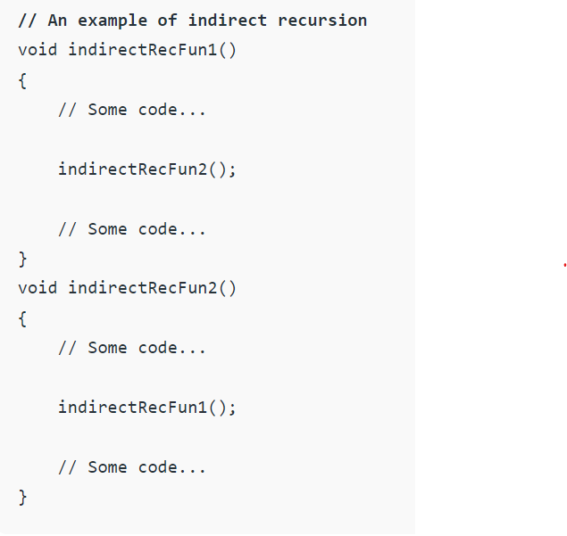
Direct and indirect recursion
A function fun is called direct recursive if it calls the same function fun.
A function fun is called indirect recursive if it calls another function say fun_new and fun_new calls fun directly or indirectly.

Slide 13
Tail Recursion
Tail recursion is defined as a recursive function in which the recursive call is the last statement that is executed by the function. So basically nothing is left to execute after the recursion call.
static void print(int n)
{
if (n < 0)
return;
System.out.print(" " + n);
// The last executed statement is recursive call
print(n - 1);
}

Slide 14
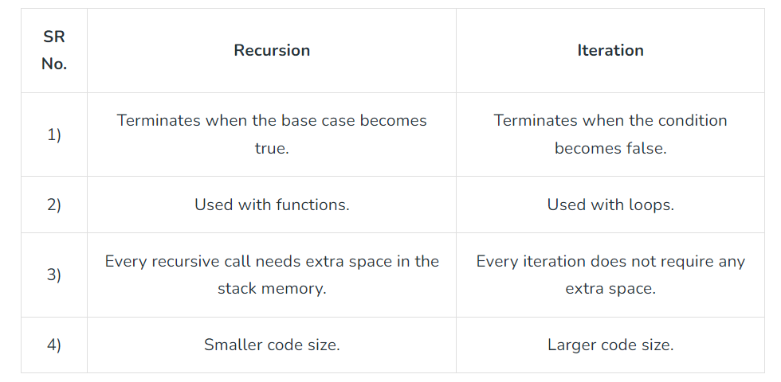
Recursion VS Iteration

Slide 15
Practice
Problem 1: Write a program and recurrence relation to find the Fibonacci series of n where n>2.
Mathematical Equation:
n if n == 0, n == 1;
fib(n) = fib(n-1) + fib(n-2) otherwise;
Recurrence Relation:
T(n) = T(n-1) + T(n-2) + O(1)
Input: n = 5
Output: Fibonacci series of 5 numbers is : 0 1 1 2 3

Slide 16
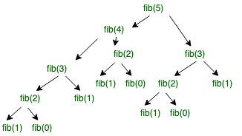
Fibonacci

Slide 17
Practice (cont.)
Problem 2: Write a program and recurrence relation to find the Factorial of n where n>2 .
Mathematical Equation:
1 if n == 0 or n == 1;
f(n) = n*f(n-1) if n> 1;
Recurrence Relation:
T(n) = 1 for n = 0
T(n) = 1 + T(n-1) for n > 0
Input: n = 5
Output: factorial of 5 is: 120

Slide 18
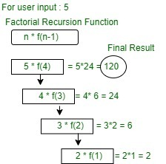
Fibonacci

Slide 19
Dynamic programing
Section 2

Slide 20
What is DP?
Dynamic Programming (DP) is defined as a technique that solves some particular type of problems in Polynomial Time. Dynamic Programming solutions are faster than the exponential brute method and can be easily proved their correctness.

Slide 21
DP Idea
The idea is to simply store the results of sub-problems so that we do not have to re-compute them when needed later.
This simple optimization reduces time complexities from exponential to polynomial.

Slide 22
Characteristics of DP Algorithm:
In general, dynamic programming (DP) is one of the most powerful techniques for solving a certain class of problems.
There is an elegant way to formulate the approach and a very simple thinking process, and the coding part is very easy.
Essentially, it is a simple idea, after solving a problem with a given input, save the result as a reference for future use, so you won’t have to re-solve it.. briefly ‘Remember your Past’ :).
It is a big hint for DP if the given problem can be broken up into smaller sub-problems, and these smaller sub-problems can be divided into still smaller ones, and in this process, you see some overlapping sub-problems.
Additionally, the optimal solutions to the sub-problems contribute to the optimal solution of the given problem.
The solutions to the sub-problems are stored in a table or array (memoization) or in a bottom-up manner (tabulation) to avoid redundant computation.
The solution to the problem can be constructed from the solutions to the sub-problems.
Dynamic programming can be implemented using a recursive algorithm, where the solutions to sub-problems are found recursively, or using an iterative algorithm, where the solutions are found by working through the sub-problems in a specific order.

Slide 23
DP Principles
Characterize structure of optimal solution, i.e. build a mathematical model of the solution.
Recursively define the value of the optimal solution.
Using bottom-up approach, compute the value of the optimal solution for each possible sub-problems.
Construct optimal solution for the original problem using information computed in the previous step.

Slide 24
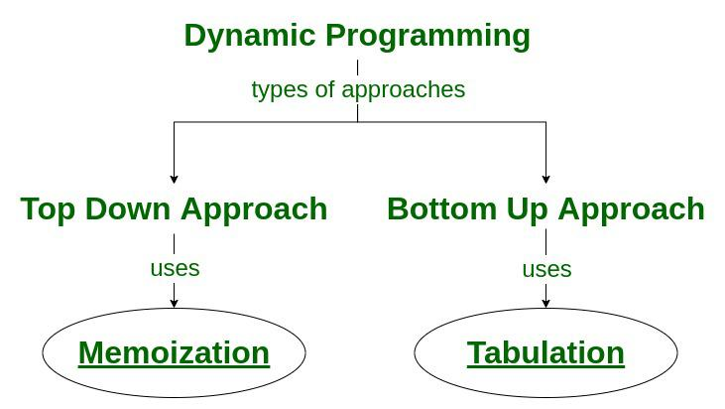
DP Techniques
Top-Down(Memoization): Break down the given problem in order to begin solving it.
Bottom-Up(Dynamic Programming): Analyze the problem and see in what order the subproblems are solved, and work your way up from the trivial subproblem to the given problem

Slide 25
Tabulation vs Memoization
Version 1: I will study the theory of DP, then I will practice some problems on classic DP and hence I will master DP.
Version 2: To Master DP, I would have to practice Dynamic problems and practice problems – Firstly, I would have to study some theories of DP from classic examples

Slide 26
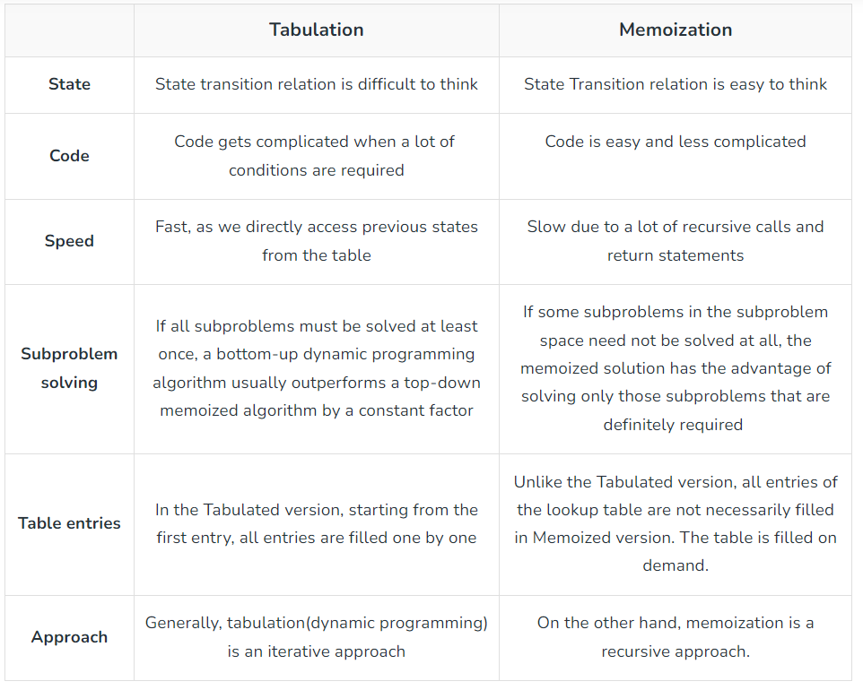
Tabulation vs Memoization

Slide 27
Steps to solve a DP problem
Identify if it is a Dynamic programming problem.
Decide a state expression with the Least parameters.
Formulate state and transition relationships.
Do tabulation (or memorization).

Slide 28
1. Identify if it is a DP problem.
Typically, all the problems that require maximizing or minimizing certain quantities or counting problems that say to count the arrangements under certain conditions or certain probability problems can be solved by using Dynamic Programming.
All dynamic programming problems satisfy the overlapping sub-problems property and most of the classic Dynamic programming problems also satisfy the optimal substructure property. Once we observe these properties in a given problem be sure that it can be solved using Dynamic Programming.

Slide 29
2) Deciding the state
A state is a collection of characteristics that can be used to specifically describe a given position or standing in a given challenge. To minimise state space, this set of parameters has to be as compact as feasible.

Slide 30
3) Formulating
The hardest part of a Dynamic Programming challenge is this step, which calls for a lot of intuition, observation, and training.
Example:
Given 3 numbers {1, 3, 5}, the task is to tell the total number of ways we can form a number N using the sum of the given three numbers.
(allowing repetitions and different arrangements).

Slide 31
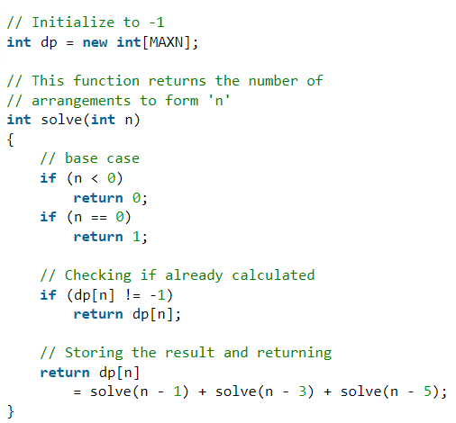
Memoization or Tabulation

Slide 32
References
<List out the main documents are used to develop this material>
<List out the further reading documents>

Slide 33
Lesson Summary
<Summarize the main points in the lesson, compared to the lesson objectives>

Slide 34
THANK YOU!

